Slide 1

BetterSwipe
“Better Rewards, Better Savings, Better Swipe”
BLUE TEAM FALL 2023
PIN: CS410

Slide 2
Table of Contents
Choosing a Credit Card Today | #2-4
The Problem | #5-10
Better Swipe | #11-14
Risk | #15-20
Market Assessment | #21
Conclusion | #22-23
References | #24-26

Slide 3

The Team
Cody Cochran
Devin
Morgan
John
Cartwright
Kyrie Champagne
Marcelo
Vargas
1
Notes:
Sources: Evans, D. S., & Schmalensee, R. (2005). Paying with Plastic: The Digital Revolution in Buying and Borrowing. MIT Press.

Slide 4
Imagine This
Your Search Results:
Chase Sapphire Preferred® Card
Capital One Venture Rewards Credit Card
Capital One Venture X Rewards Credit Card
Chase Freedom Unlimited®
The Platinum Card® from American Express
Ink Business Preferred® Credit Card
Wells Fargo Autograph℠ Card
U.S. Bank Altitude® Connect Visa Signature® Card
American Express® Gold Card
Citi Premier® Card
Bank of America® Travel Rewards credit card
Chase Sapphire Reserve®
Chase Freedom Flex℠
Delta SkyMiles® Gold American Express Card
World of Hyatt Credit Card
PenFed Pathfinder® Rewards Visa Signature® Card
Capital One Spark Miles for Business
Chase Sapphire Reserve
And many more (8)
You get a new job and to need travel regularly
You’re looking for a way to get rewarded during your travels
You decide to look for the best travel reward credit cards to fit your needs and budget
2

Slide 5

There are to many rewards cards
Credit Karma shows 116 credit cards to choose from (5)
There are 13 criteria to compare rewards credit cards with (6)
Consumers postpone decision-making with 10 or more decisions (7)
72% of Americans own a credit card (15)
Only 36% of them use rewards credit cards for everyday purchases (2)
88% use their credit card less than 3 times per month (1)
69% of reward credit card holders are underutilizing their rewards (3)
3

Slide 6

Choosing Rewards Credit Cards Today
Identify your Reward Preferences
Examine Spending Patterns
Picking the Right Card
4
Notes:
Sources:
Bankrate. (n.d.). How to choose a rewards credit card. Retrieved [Date you accessed the page], from https://www.bankrate.com/finance/credit-cards/choose-rewards-credit-card/
Bankrate. (n.d.). Are rewards credit cards worth it?, from https://www.bankrate.com/finance/credit-cards/are-rewards-credit-cards-worth-it/#pros-cons
Identify your Reward Preferences
Determine the types of rewards you wish to earn: points, cash back, or miles for traveling.
Examine Spending Patterns
Examine your current spending patterns and categorize your major expenditures
Compare Cards
Based on your current spending patterns choose a card that matches your major spending categories, interest rates, and fees
Compare their rewards based on what you spend money on the most

Slide 7
🍎🍊Comparing Cards can be like Comparing Apples to Oranges🍎🍊
* Top 3 credit cards of each reward type according to NerdWallet (5)
 | Wells Fargo Active Cash | Capital One Venture | Chase Sapphire Preferred
Initial Offer | $200 when spending $500 in the first 3 months | 75000 bonus miles when spending $4000 in the first 3 months | 60000 bonus points when spending $4000 in the first
Rewards on any purchase per dollar spent | 2% cash back | 2 miles | 2 points
Rewards on food/groceries | 2% cash back | 2 miles | 3 points
Rewards on proprietary affiliate purchases | N/A | 5 miles | 5 points
5

Slide 8
Rewards from a 1 Week Trip:
$500 plane ticket (Delta), $860 hotel (Holiday Inn), $300 car rental (Hertz)
Wells Fargo Active Cash Card (18)
2% cash back on total price = $16.60
Chase Sapphire Preferred Card (19)
5x points on hotel (IHG partner) (4300 points)
2x points on flight / car rental (1600 points)
1.25¢ per point: $5900 points total = $73.75
Capital One Venture Card: (20)
5 miles on hotel / car rental purchases (5800 miles)
2 miles on flight (1000 miles)
1¢ per mile: 6800 miles total = $68.00
How would results change if other purchases were factored?
6

Slide 9
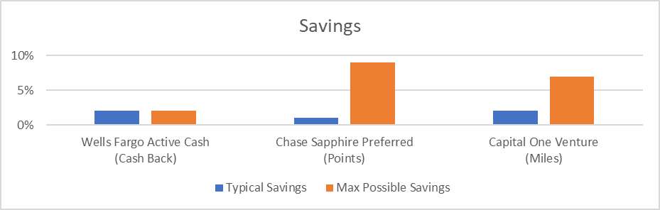
Savings Based on Spending Habits
Chase Sapphire Preferred (16)
Typical: $1 → 1 pt → $0.01 (cash)
Max: $1 (Chase Travel) → 5x pts → 5x $0.018 (Virgin Atlantic Flying Club)
Capital One Venture (17)
Typical: $1 → 2 miles → 2x $0.01 (cash)
Max: $1 (hotel/car rental) → 5 miles → 5x $0.014 (Air Canada)
7

Slide 10
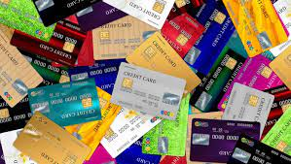
Rewards Cards Can Save You Money
Consumers have a significant potential in savings through the use of rewards credit cards, but choosing the right card to maximize their savings is complicated.
usatoday.com
8
Notes:
Image Sources:
https://www.usatoday.com/money/blueprint/credit-cards/how-many-credit-cards-should-i-have/

Slide 11
The Rewards Card Selection Conundrum
Current solutions require consumers to manually determine which cards are best for them
Hundreds of credit cards to choose from
3 different reward systems (cash, points, miles)
Expense types (travel, food, etc.) have different reward values per dollar spent
Return value of rewards can vary based on how they are redeemed
Consumers need a way to help select rewards cards based on their spending habits
9

Slide 12
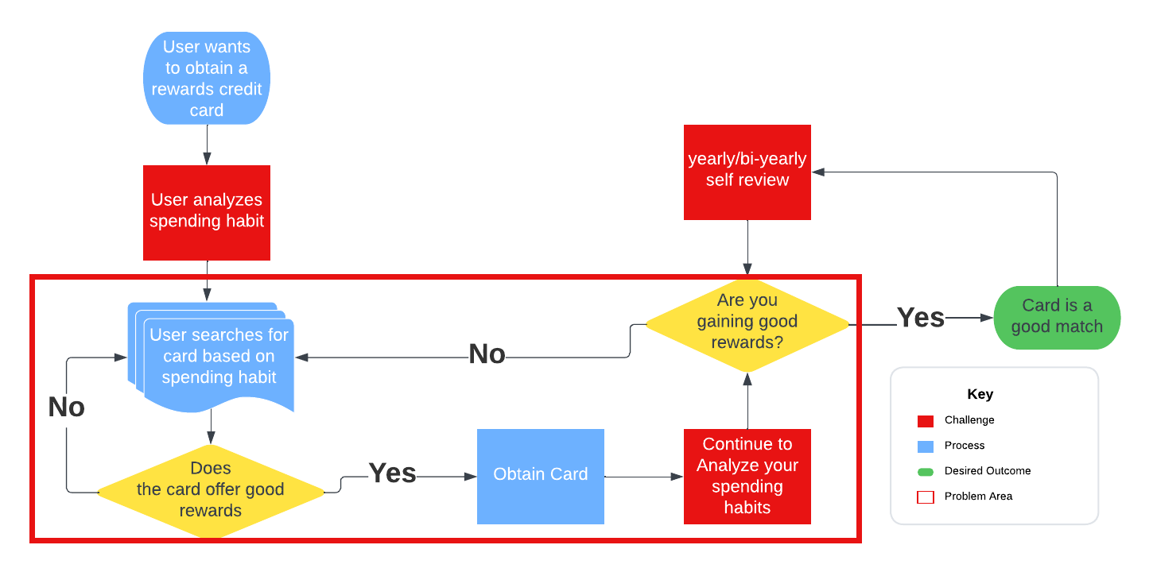
10

Slide 13
Solution Statement
BetterSwipe is a tool that provides individuals who are seeking to maximize their savings through the use of rewards credit cards by helping them make an informed decision based on their spending profile.
11

Slide 14

Solution Characteristics
Build a spending profile from previous transactions.
Continuous monitoring of spending habits
Recommend rewards credit cards based on the spending profile that the user has developed
Take the analysis work away from the user
Simplifies the reward card selection process
12
Notes:
Image source:
https://www.quicken.com/goals/see-where-my-money-is-going/
businesswoman-relax-from-work-at-the-office.jpg

Slide 15
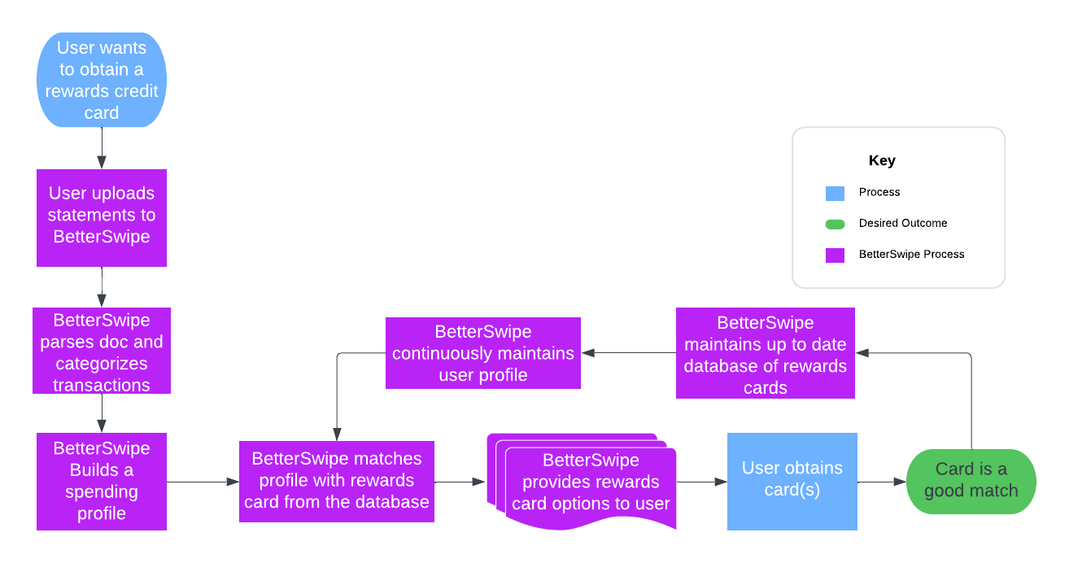
I’d rather Multiple choice than fill in the blank
13

Slide 16
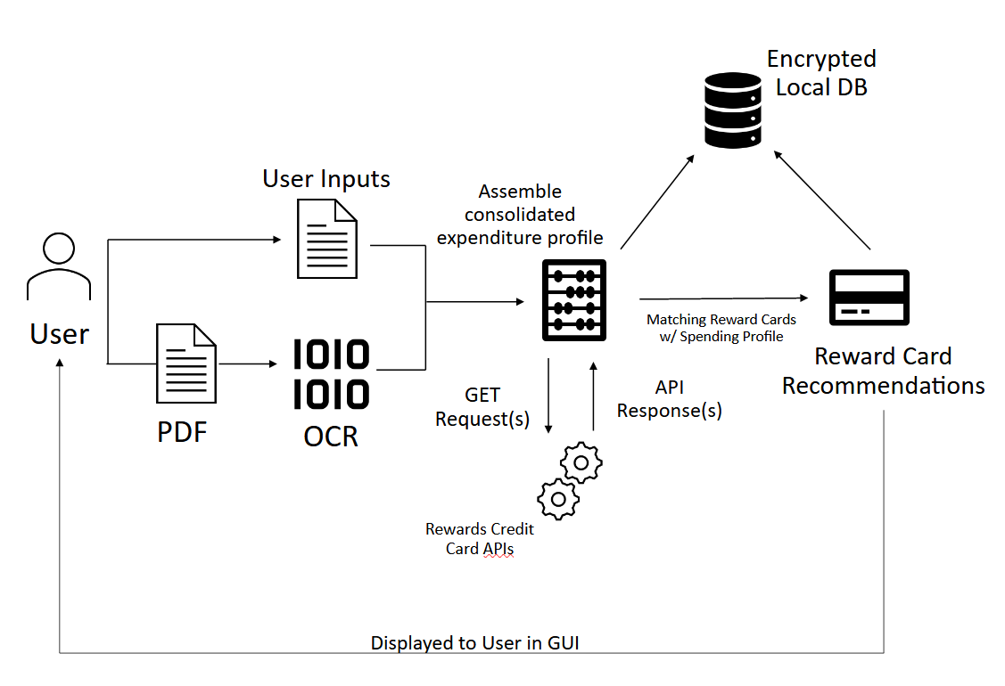
Major Functional Component Diagram
14
Notes:
Sources: https://shourai.io/blog/2020/07/17/web-application-development-the-basic-concepts/
https://www.allerin.com/blog/what-is-mobile-app-integration

Slide 17
Security Risk Matrix
Security Risks | Mitigations
S1..Risk of Personal Identifiable Information (PII) and sensitive information being accessed
S1. Follow the currents standards for protecting PII according to National Institute of Science and Technology Privacy Framework
S1. Encrypt all data-at-rest and ensure encrypted API calls
5 Very Likely
4 Likely
3 Possible
2 Unlikely
1 Very Unlikely
 |  | S3 | S2 | S1
 | S3 | S2 | S1
Probability
1 insignificant 2 minor 3 moderate 4 significant 5 catastrophe
Impact
S2..Unauthorized user(s) accessing profile(s)
S2. Implement Multi-Factor Authentication (MFA) and strong password requirements
S3..Use of API(s)
S3. Implement API Gateway and SSL/TLS
15

Slide 18
Customer Risk Matrix
Customer Risks | Mitigations
C1..Customer does not find satisfactory solution
C1. Test thoroughly for multiple profile cases
C2..Customer adds erroneous inputs.
C2. Implement input validation and allow user to confirm choices
5 Very Likely
4 Likely
3 Possible
2 Unlikely
1 Very Unlikely
 | C1 | C2
 | C1 | C2
Probability
1 insignificant 2 minor 3 moderate 4 significant 5 catastrophe
Impact
16

Slide 19
Technical Risk Matrix
Technical Risks | Mitigations
T1. App unable to access API(s)
T1. Test API(s) and cache responses
T2. Data from credit card providers not up to date
T2. Consistently monitor API(s) for updates and implement most up-to-date card information
5 Very Likely
4 Likely
3 Possible
2 Unlikely
1 Very Unlikely
 |  |  | T1
 |  | T2
 | T2 |  | T1
Probability
1 insignificant 2 minor 3 moderate 4 significant 5 catastrophe
Impact
17

Slide 20
Competition Matrix
Product Category | Better Swipe | NerdWallet | Bankrate | Finder
Rate Cards |  | ✅ | ✅ | ✅
Search for best of each type |  | ✅ | ✅ | ✅
Find cards based on credit score |  | ✅ | ✅ | ✅
Match cards based on intention |  | ✅ | ✅ | ❌
Match cards based on personal habits | ✅ | ✅ | ✅ | ❌
Compare cards side by side |  | ✅ | ❌ | ❌
Continuous monitoring for lifestyle changes | ✅ | ❌ | ❌ | ❌
Reminders for reward use | ✅ | ❌ | ❌ | ❌
Automatic input with bank statements | ✅ | ❌ | ❌ | ❌
18

Slide 21
Conclusion - Key Points Summary
Searching for credits cards has become problematic over the years with the addition of credit card rewards.
The differences of credit card rewards and the amount of them are what make this issue and problem to be solved
BetterSwipes goal is to make this process easier and allow people to find a credit card tailored to their needs
Using Artificial Intelligence to read bank statements to tailor credit card options
Educating customers on how to properly using credit cards for their benefit
There is some risk to using this software
Potential Personal Identification Information being wrongly accessed and leaked
Constant updates of the credit card companies information for customer choices
19

Slide 22
Conclusion - Who Benefits/Importance/Why Feasible
The people that benefit from this solution are the millions of people who are currently looking for credit cards that fit their needs
Being able to find credit cards specifically for your needs helps people maximize maximize their money and allows it to work for them and gain rewards while doing so
This product is feasible because a bases for the software is already in production and being able to add the functionality that we are suggesting will add for a more personalized and efficient way to finding credit cards
20

Slide 23
References
1) Bankrate. (n.d.). How to choose a rewards credit card., from https://www.bankrate.com/finance/credit-cards/choose-rewards-credit-card/
2) Bankrate. (n.d.). Are rewards credit cards worth it?, from https://www.bankrate.com/finance/credit-cards/are-rewards-credit-cards-worth-it/#pros-cons
3) Dodgson, L. (2018, October 4). Why Too Much Choice Is Bad. Business Insider. https://www.businessinsider.com/why-too-much-choice-is-bad-2018-10
4) ScienceDirect. (2014). The Effect of Too Many Choices on Consumer Satisfaction in Online Sales Environments. https://www.sciencedirect.com/science/article/pii/S2212567114002007/pdf?md5=26ae6e12a34221c1f26fe30622eafbee&pid=1-s2.0-S2212567114002007-main.pdf&_valck=1
5) NerdWallet. (2023, July 7). How to Read the Schumer Box on a Credit Card. Retrieved October 11, 2023, from https://www.nerdwallet.com/article/credit-cards/how-to-read-schumer-box 6) Lambright Black, M. (2022, August 15). Study: Millions Leave Credit Card Rewards Unredeemed. LendingTree. Retrieved October 11, 2023, from https://www.lendingtree.com/credit-cards/study/unused-rewards/ 7) Pokora, B. (2023, March 9). Credit Card Statistics: 23 Must-Know Data Points for 2023. Forbes. Retrieved October 11, 2023, from https://www.forbes.com/advisor/credit-cards/credit-card-statistics/
8) Fontinelle, A. (2021, May 17). Credit Cards vs. Debit Cards: What's the Difference? Investopedia. Retrieved October 11, 2023, from https://www.investopedia.com/articles/pf/10/credit-card-debit-card.asp
9) GÜL, Z., & İŞCAN, O. (2022). Understanding Consumer Behavior towards Credit Card Usage in Bangladesh. ISARDER. Retrieved October 11, 2023, from https://isarder.org/index.php/isarder/article/view/1693/1642
21

Slide 24
References
10) DOI.org. (2023). International Journal of Finance and Managerial Research, 05(03). https://dx.doi.org/10.36948/ijfmr.2023.v05i03.2874 11) Finder.com.au. (n.d.). Credit Cards: Compare the Best Credit Card Deals | Finder. https://www.finder.com.au/credit-cards/best-credit-card-deals?futm_medium=cpc&futm_source=google&futm_campaign=16481049116~137063429267&futm_term=credit%20card%20comparison~b~g~kwd-10670281&futm_content=~~CjwKCAjw69moBhBgEiwAUFCx2B_wph6NS3HF9mdfql4hFYQQeywNXOKVNQaeuKq7cQVG2V026d_IkRoCpLMQAvD_BwE&gclid=CjwKCAjw69moBhBgEiwAUFCx2B_wph6NS3HF9mdfql4hFYQQeywNXOKVNQaeuKq7cQVG2V026d_IkRoCpLMQAvD_BwE 12) Bankrate. (n.d.). How to choose a rewards credit card. Retrieved [Date you accessed the page], from https://www.bankrate.com/finance/credit-cards/choose-rewards-credit-card/ 13) Bankrate. (n.d.). Are rewards credit cards worth it?, from https://www.bankrate.com/finance/credit-cards/are-rewards-credit-cards-worth-it/#pros-cons 14) Akash Chauhan, & Anshu Goal. (2023). Comparative study between debit card & credit card users in Greater Noida City. 15) The Motley Fool. (2020). Credit and Debit Card Market Share by Network and Issuer. Retrieved from https://www.fool.com/the-ascent/research/credit-debit-card-market-share-network-issuer/
22

Slide 25
References
16) NerdWallet. (2023). What’s the Value of Chase Ultimate Rewards Points? Retrieved from https://www.nerdwallet.com/article/travel/chase-ultimate-rewards-points-value#:~:text=Based%20on%20our%20most%20recent,Ultimate%20Rewards%C2%AE%20redemption%20options. 17) NerdWallet. (2023). What’s the Value of Capital One Miles? Retrieved from https://www.nerdwallet.com/article/travel/capital-one-miles-value#:~:text=Capital%20One%20miles%20are%20worth,transfer%20partners%20at%201.4%20cents. 18) Wells Fargo. (2023). Wells Fargo Active Cash Card. Retrieved from https://creditcards.wellsfargo.com/cards/active-cash-credit-card/?product_code=CC&subproduct_code=AC&FPID=0126D7IDF40000&vendor_code=LS&sub_channel=AFF&siteID=SWlnSnn6x54-VBFI3LHxdVpqwHmPYdNihg 19) Chase. (2023). Sapphire Preferred. Retrieved from https://creditcards.chase.com/a1/23Q3a/sapphirepreferred/compare?CELL=6H8X&AFFID=SWlnSnn6x54-uFq.wEnPmd6AIGJp3kVUng&pvid112b6c9a7e784f3fba5eec3490744a4b&jp_cmp=cc/1431835/aff/15-31715/na 20) Capital One. (2023). Venture. Retrieved from https://applynow.capitalone.com/?irgwc=1&external_id=IRAFF_ZZce293c61587c41c29a64c5685cb78e40_USCIR_K170911_A344893L_C0bcf2f83N684a11ee9b4547fc6474d6a_S_P&transid=&marketingChannel=P23235&oC=COh7rTP9h&productId=24919
23

Slide 26
Image Source
https://shourai.io/blog/2020/07/17/web-application-development-the-basic-concepts/
https://www.allerin.com/blog/what-is-mobile-app-integration
https://credit.org/blog/the-benefits-of-having-credit-cards/
https://www.quicken.com/goals/see-where-my-money-is-going/
https://www.usatoday.com/money/blueprint/credit-cards/how-many-credit-cards-should-i-have/
https://www.google.com/url?sa=i&url=https%3A%2F%2Fwww.sharecare.com%2Fmental-health-behavior%2Fstress-management%2F8-warning-signs-of-too-much-stress&psig=AOvVaw3YHRcYnBJ3YixeBKOiTGpJ&ust=1697662494403000&source=images&cd=vfe&opi=89978449&ved=0CBAQjRxqFwoTCLCTv-T7_YEDFQAAAAAdAAAAABAL
24

Slide 27
Thank you and Questions?

